Slide 1
Enterprise Resource Planning (ERP)
ERP is short for enterprise resource planning.
ERP is a set of integrated business applications, or modules which carry out common business functions such as general ledger, accounting, or order management.
IT software that integrates business activities across an enterprise

Slide 2
An ERP system is an attempt to integrate all functions across a company to a single computer system that can serve all those functions’ specific needs.
Support business through optimizing, maintaining, and tracking business functions.
From product planning, parts purchasing, inventory control, and product distribution, to order tracking.

Slide 3
Components OF ERP
Accounting and Finance
This gathers and manage financial data and financial processes from various functional departments and generates valuable financial reports such as balance sheet, general ledger; trial balance and quarterly financial statements.
2. Human Resources
This component maintains a employee database containing information about employees contact information, salary details, attendance, performance evaluation and promotion details.
This component helps the management to make use of the employees best talent.

Slide 4
3. Manufacturing
This component provides the information needed for the manufacturing process to take place.
• It contains number of manufacturing methods, so that the organization can choose the best which fits for them
• Bills of Material, Scheduling, Capacity, Workflow Management, Quality Control, Cost Management, Manufacturing Process, Manufacturing Projects, Manufacturing Flow.

Slide 5
4. Projects Management
Project management is the discipline of planning, organizing, motivating, and controlling resources to achieve specific goals.
Costing, Billing, Time and Expense, Activity Management
5. Customer Relationship Management
Involves managing all aspects of a customer’s relationship with an organization to increase customer loyalty and retention and an organization’s profitability.
Sales and Marketing, Commissions, Service, Customer Contact and Call Centre support. Components OF ERP!

Slide 6
6. Supply Chain Management
Supply Chain Management (SCM), sometimes referred to as logistics, improves the flow of materials through an organization by managing planning, scheduling, procurement, and fulfilment, to maximize customer satisfaction and profitability.

Slide 7
E- CRM
CRM is a strategy by which companies optimise profitability through enhanced customer satisfaction.
CRM is about automating and enhancing the customer- centric business processes of Sales, Marketing, and Service.
CRM also focuses on added customer loyalty that directly affects the organization’s bottom line.

Slide 8
ECRM is the customer focussed management of the whole e Business relationship with each customer, in order to measure, create and increase income and reduce costs for each customer & segment and thus to generate greater positive lifetime value .
e CRM means CRM-database access via the Web. It means Intranet access for internal users, extranet access for business partners and customers and of course, Internet access for the market at large.

Slide 9
e-CRM expands the traditional CRM techniques by integrating new electronic channels, such as Web, wireless, and voice technologies and combines it with e-business applications into the overall enterprise CRM strategy.
Traditional CRM + Internet = e-CRM

Slide 10
Why E-CRM
Due to the introduction of new technology
Due to globalization
Changing customer attitudes and expectations
To gain competitive advantage
To measure, create and increase income for the business
To reduce costs

Slide 11
Technical e-CRM Capabilities
Customer analytic software predicts, measures, and interprets customer behaviours, allowing companies to understand the effectiveness of e-CRM efforts.
Data mining software builds predictive models to identify customers most likely to perform a particular behaviour.
Campaign management software leverages the data warehouse to plan and execute multiple, highly targeted campaigns overtime, using triggers that respond timed events and customer behaviour.
Business simulation used in conjunction with campaign management software optimises offer; messaging and channel delivery prior to the execution of campaigns, and compares planned costs and ROI projections with actual results.
A real time decision engine coordinates and synchronises communications using business intelligence.

Slide 12
E-CRM planning 7 C’S
Context
Content
Community
Customization
Communication
Connection
Commerce

Slide 13
SCM
“A supply chain is a network of supplier, manufacturing, assembly, distribution and logistics facilities that perform the functions of procurement of materials, transformation of these material into intermediate and finished products, and the distribution of these products to customers ”
“Supply Chain Management as the integration of business process from the end user through original supplier who provide products, services and information that adds value for the customers. ”

Slide 14
“A supply chain is a network of facilities and distribution options that perform the function of procurement of material transformation of these materials into intermediate and finished products, and the distribution of these finished products to customers. ”

Slide 15
Types of supply chain.
Raw supply chain.
Ripe supply chain.
Internal supply chain.
Extended supply chain.
Self monitored Supply Chain.
Outsourced supply Chain.

Slide 16
Components of supply chain management
Procurement.
Processing.
Distribution.

Slide 17
Intellectual property
Intellectual property (IP) refers to creations of the mind, such as inventions; literary and artistic works; designs; and symbols, names and images used in commerce.
Intellectual Property Rights (IPRs) are legal rights that protect creations and/or inventions resulting from intellectual activity in the industrial, scientific, literary or artistic fields.
IP is protected in law by, for example, Patents, Trademarks, Copyrights, which enable people to earn recognition from what they invent or create.

Slide 18
The main purpose of intellectual property law is to encourage the creation of a wide variety of intellectual goods. To achieve this, the law gives people and businesses property rights to the information and intellectual goods they create, usually for a limited period of time. This gives economic incentive for their creation, because it allows people to benefit from the information and intellectual goods they create, and allows them to protect their ideas and prevent copying. These economic incentives are expected to stimulate innovation and contribute to the technological progress of countries, which depends on the extent of protection granted to innovators.

Slide 19
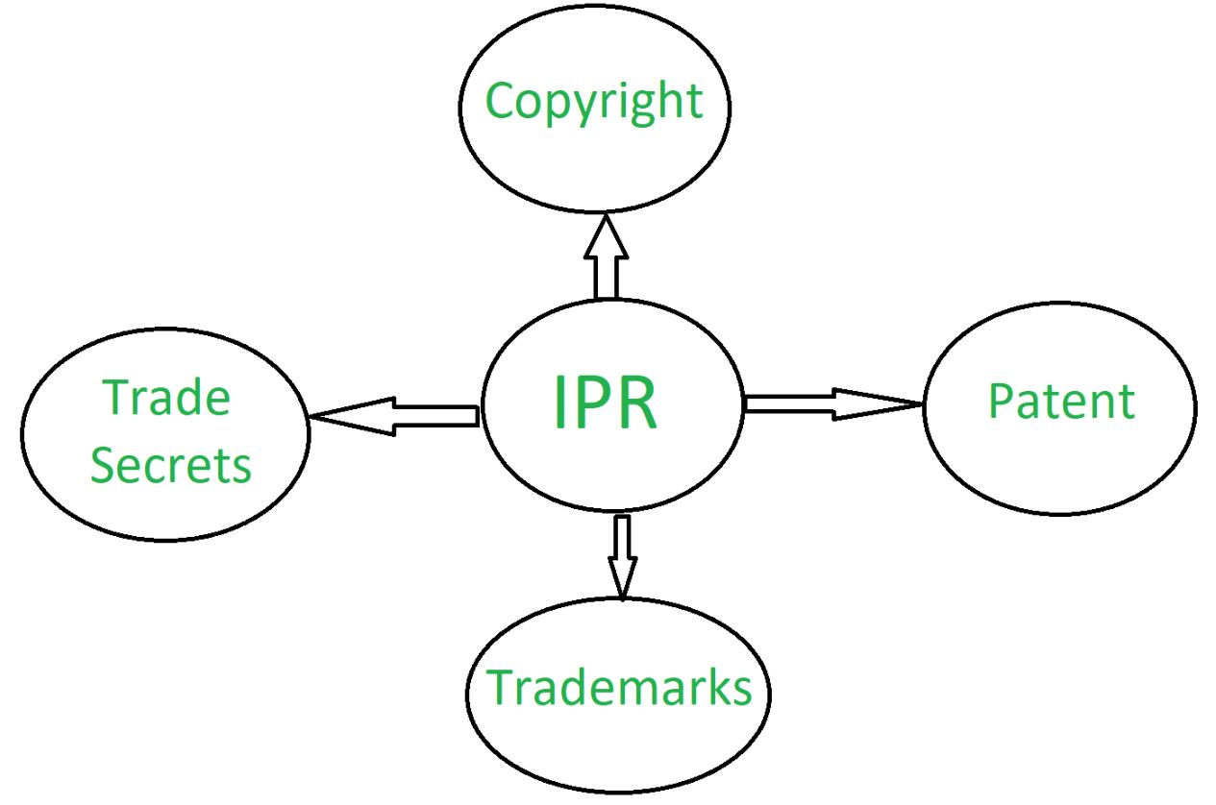
Types of IPR

Slide 20
Patent
A patent is an exclusive right granted for an invention, which is a product or a process that provides, in general, a new way of doing something, or offers a new technical solution to a problem

Slide 21
Invention patentable if….
Novelty An invention will be considered novel if it does not form a part of Information appearing in magazines, technical journals, books, newspapers etc. Oral description of the invention in a seminar/conference can also spoil novelty
Inventiveness (Non-obviousness) The invention is not obvious to a person skilled in the art in the light of the prior publication/knowledge/ document.
Usefulness An invention must possess utility for the grant of patent. No valid patent can be granted for an invention devoid of utility.

Slide 22
Trademark
A trademark is a sign capable of distinguishing the goods or services of one enterprise from those of other enterprises.
A trademark helps consumers to identify and choose between products/services based on their reputation and quality.
Coca-Cola registered since 1887 Nike registered since 1971

Slide 23
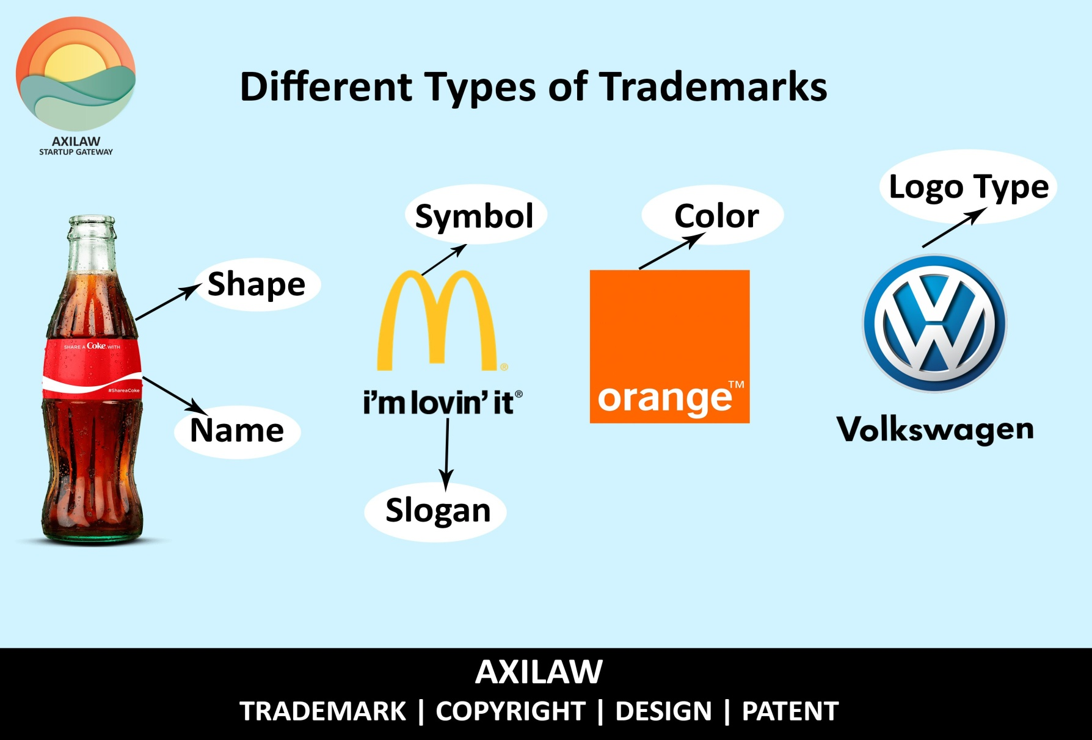

Slide 24
Copyright
Copyright is a legal means of protecting an author's work. It is a type of intellectual property that provides exclusive publication, distribution, and usage rights for the author. ... Many different types of content can be protected by copyright.
The creative work may be in a literary, artistic, educational, or musical form. Copyright is intended to protect the original expression of an idea in the form of a creative work, but not the idea itself.
Examples include books, poems, plays, songs, films, and artwork.

Slide 25
Trade secrets
A trade secret is any practice or process of a company that is generally not known outside of the company. Information considered a trade secret gives the company a competitive advantages over its competitors and is often a product of internal research and development
To be legally considered a trade secret in the United States, a company must make a reasonable effort in concealing the information from the public; the secret must intrinsically have economic value, and the trade secret must contain information. Trade secrets are a part of a company's intellectual property. Unlike a patent, a trade secret is not publicly known.

